Slide 1
Training models: Gradient Descent
Jens Peter Andersen, Assistant Professor, Roskilde
Michael Claudius, Associate Professor, Roskilde, with respect and gratefullness to Jens Peter Andersen

Slide 2
Training models: Opening The Black Box
It is about understanding what goes on behind the stage when models are trained and fitted to labels!
Linear regression refreshed
Define the cost function
Minimize the cost function, two types
Closed Form Solution (Normal Equation)
Gradient Descent Solutions: Batch GD, Stochastic GD (SGD), Mini-Batch GD
Regularize Linear Models to avoid vulnerabilities
Overfitting, Underfitting, Learning Curves, Early Stopping

Slide 3
Closed Form: Evaluation
Typical complexity for closed form computations:
Training the model with m feature instances is complexity O(m) – proportional to number of instances m
Training the model with n features is complexity O(n^{(>2)}) – proportional to quadratic number of features n⁽²⁾
– e.g. increasing n by a factor 2 will increase processing resources needed by 2²=4
– e.g. increasing n by a factor 10 will increase processing resources needed by 10²=100 ! That’s 100 times slower
Processing resources are time and memory
Advantage: Simple to compute
Disadvantage: Slow for high number of features (n > 10.000)
Examples: predicting on basis of the human genom
We are lucky. Why? There is the Gradient Descent Solutions for these cases.
BUT let us look at some code first.

Slide 4
Gradient Descent Solutions
We are lucky. There is the Gradient Descent Solution for these cases.
Batch GD,
Use the whole training set to calculate gradients at each step
Advantage: simple
Disadvantage: Slow for a large training set
Stochastic GD (SGD)
Choose randomly one instance each time and calculate the gradient based on this instance
Advantage: Fast, will come close to minimum
Disadvantage: irregular path and bounce around the minimum
Solution: Needs a good learning schedule
Mini-Batch GD
Choose randomly a batch; i.e. a set of instances each time and calculate the gradient based on this instances
Advantage: Fast, will come close to minimum, more regular than SGD
Disadvantage: bounce around the minimum
Solution: Needs a good learning schedule
BUT first we will look at the principles behind Gradient Descent

Slide 5
Gradient descent – General learning approach
Applicable for various kinds of models, which includes:
Linear
Polynomial
Logistic regression (classification)
Out of core (memory) learning is possible
Slow when m – the number of instances increases
Faster then normal equation, when n - the number of model paramters θ₁,…,θ_{n} - i.e. number of features increase

Slide 6
Gradient descent – Minimizing MSE
Applied in order to optimize by minimizing a so-called cost function – typically MSE in machine learning.
Here the Mean Square Error is a function of the model parameters – that is MSE(θ₁,…,θ_{n})
‘Gradient’ refers to observing on the slope of the cost function – negative, zero or positive.
We want to end up in a set of values for θ₁,…,θ_{n} where the slope of the cost function is zero – that means minimum reached.
‘Descent’ refers to that we are adjusting the values of θ₁,…,θ_{n} in the direction where the cost function diminishes

Slide 7
Linear model - Mean squared error (MSE)
Problem: Finding the model parameters θ₀ and θ₁
ŷ= θ₀ + θ₁ x₁
Solution: Finding the model parameters θ₀ and θ₁ by minimizing MSE:
MSE(θ_{1,} θ₀)= 1/N Σ_{i=1..N} (y_{i} – (θ₁ x_{i} + θ₀ ))²

Slide 8
Linear model - Mean squared root error
Mathematically we want to calculate the so-called partially derivative with respect
to all model parameters in order to approach the minimum for MSE.
With 2 model parameters the partially derivatives are expressed like this :
∂MSE(θ_{1,} θ₀)/ ∂θ₁ - Expresses slope in the direction of θ₁
∂MSE(θ_{1,} θ₀)/ ∂θ₀ - Expresses slope in the direction of θ₀
Don’t worry we will look at the curves soon

Slide 9
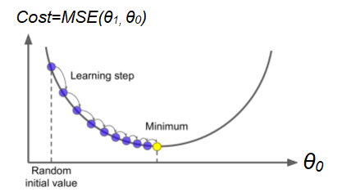
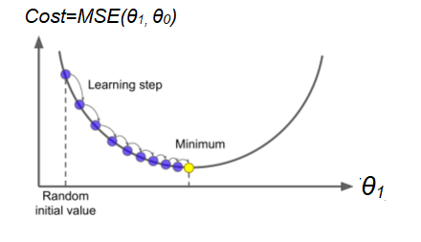
Performing Gradient Descent
Now lets watch a video on Gradient Descent: Gradient Descent Statquest
Afterwards explain to yourselves in the groups the process on how the cost function Mean Square Error (MSE) goes towards the minimum, use curves below for help.

Slide 10
Performing Gradient Descent – the principle
While (Minimum not reached)
{
Based on the learning set:
θ₀ ₌ = θ₀ - LearningRate * ∂MSE(θ_{1,} θ₀) / ∂θ₀
θ₁ ₌ = θ₁ - LearningRate * ∂MSE(θ_{1,} θ₀) / ∂θ₁
}

Slide 11
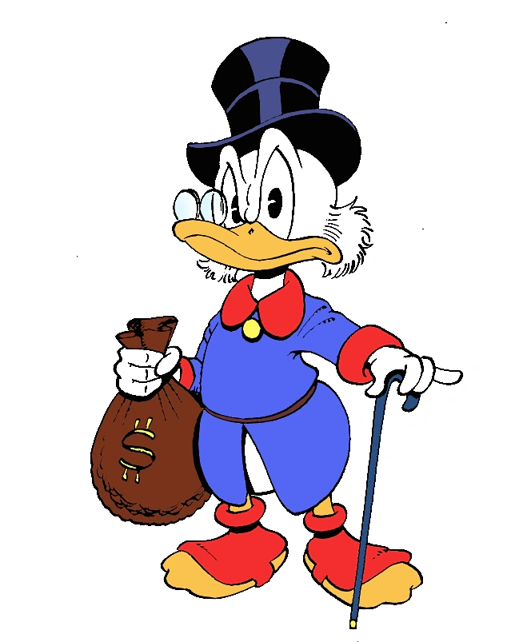
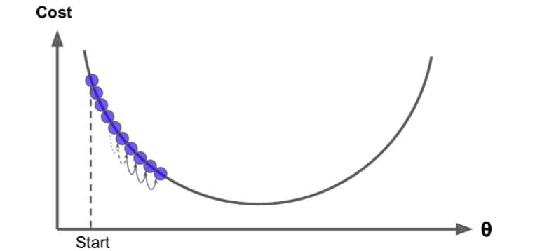
Being too ‘scrooge’ with the learning rate
Learning rate is too small will make gradient descent too slow
That is, the model parameters θ_{0 ...} θ_{n} are changed in small steps slowing down the algorithm
Eventually MSE(θ_{0, ….,} θ_{n}) will converge towards a minimum

Slide 12
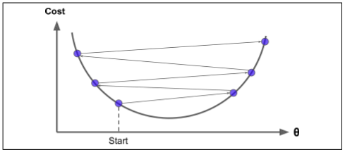
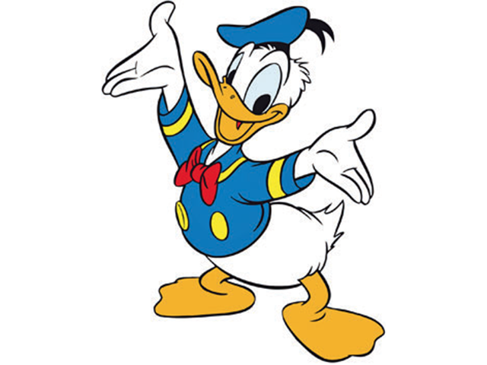
Being too ‘greedy/lazy’ with the learning rate
Learning rate is too big will make gradient descent diverge away from finding the minimum MSE(θ_{0, ….,} θ_{n})
That is, the model parameters θ_{0 ...} θ_{n} are changing in big steps that makes the learning algorithm get lost

Slide 13
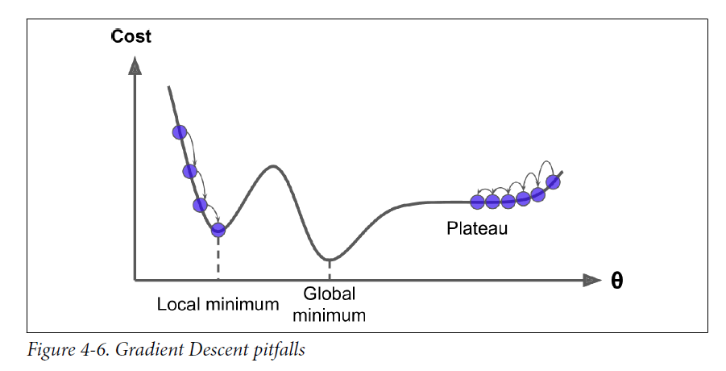
Cost function: Challenges
IF the cost function is “not nice” not-convex function with irregular shape with holes, ridges, plateaus then
GD finds a local minimum
GD takes long time to pass a plateau
BUT we are lucky again. Why? The MSE cost function is a convex function !

Slide 14
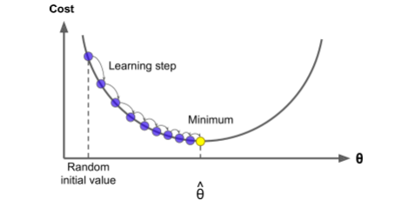
Nice linear regression properties MSE cost function
The MSE cost function for a Linear Regression model a so-called convex function
Convex: Red line segment will never cross the curve below
This means that is has only one global minimum.
It is a continuous function with a slope that never changes abruptly
Gradient Descent is then guaranteed to approach arbitrarily close the global minimum.

Slide 15
Gradient Descent – Feature scaling needed
Feature scaling: Features (learning input) have same order of magnitude – e.g. in the the area -1 to 1
To the left: Feature scaling applied -> Minimum of cost function approached faster
To the right: Feature scaling not applied -> Minimum of cost function approached slower
Feature scaling can be obtained by the Scikit-Learn’s StandardScaler
Feature scaling is recommended for gradient descent algorithms

Slide 16
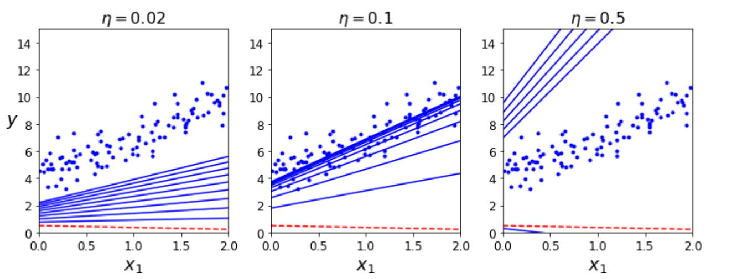
Gradient Descent: the learning rate - example
To the left: ‘Scrooge’ learning rate η = 0.02 – too small approaching MSE optimum slowly
In the middle: ‘Appropriate’ learning rate η = 0.1 – approaches MSE optimum in reasonable time
To the right: ‘Lazy’ rate η = 0.5 – too big missing MSE optimum

Slide 17
Stochastic Gradient Descent: The Principle
Instead of processing the entire training set, we randomly pick one training set instance at a time
Faster than the Batch Gradient Descent
But more erractic
While (Minimum not reached)
{
Based on picking one element at a time in the learning set randomly:
θ₀ ₌ = θ₀ - LearningRate * ∂MSE(θ_{1,} θ₀) / ∂θ₀
θ₁ ₌ = θ₁ - LearningRate * ∂MSE(θ_{1,} θ₀) / ∂θ₁
}

Slide 18
Mini-Batch Gradient Descent: The principle
Instead of processing the entire training set, we pick a batch training set instance at a time
Trade of between batch gradient descent and stochastic gradient descent
Fast and less erractic
While (Minimum not reached)
{
Based on picking batch of elements at a time in the learning set randomly:
θ₀ ₌ = θ₀ - LearningRate * ∂MSE(θ_{1,} θ₀) / ∂θ₀
θ₁ ₌ = θ₁ - LearningRate * ∂MSE(θ_{1,} θ₀) / ∂θ₁
}

Slide 19
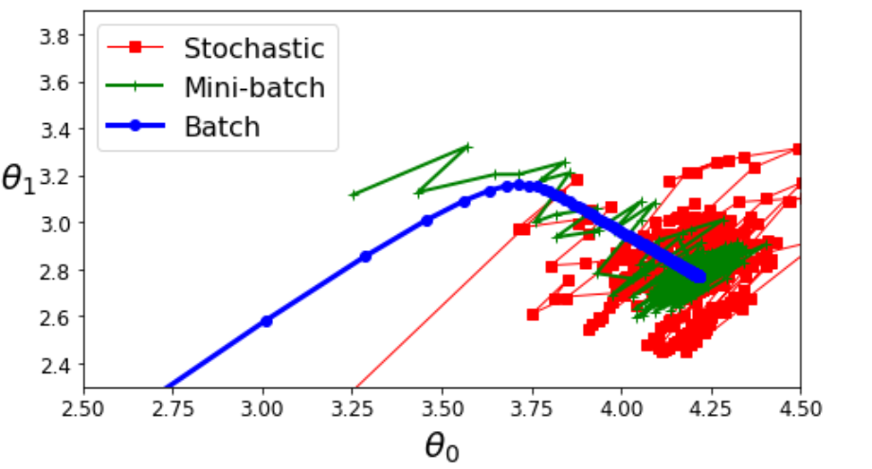
Comparing gradient descent approaches
Different paths in development in model parameters

Slide 20
Gradient Descent Evaluation
We are lucky. There is the Gradient Descent Solution for these cases.
Batch GD,
Use the whole training set to calculate gradients at each step
Advantage: Simple
Disadvantage: Slow for a large training set
Stochastic GD (SGD)
Choose randomly one instance each time and calculate the gradient based on this instance
Advantage: Fast, will come close to minimum
Disadvantage: irregular path and bounce around the minimum
Solution: Needs a good learning schedule
Mini-Batch GD
Choose randomly a batch; i.e. a set of instances each time and calculate the gradient based on this set of instances
Advantage: Fast, will come close to minimum, more regular than SGD
Disadvantage: bounce around the minimum
Solution: Needs a good learning schedule
So lets compare the different solutions

Slide 21
Some comparison on linear regression algorithms

Slide 22
That’s all folks
Don’t let a little Gorilla Math scare you !

